Slide 1

Coursera Course Success Prediction App
Submitted By
Ranjitha P V
DSA Feb Batch 25

Slide 2
Problem Statement
Need to predict learner course success score early
Helps in targeted intervention and learner support

Slide 3
Project Objectives
Understand learner behavior through data analysis
Build an optimized regression model
Deploy the model as an interactive web application

Slide 4
Dataset Overview
Coursera learner and course interaction dataset
Includes course title, price,student enrollment,instructor profile,rating,
review count
Target variable: Course Success Score

Slide 5
Data Preprocessing
Handled missing values and duplicates
Encoded categorical variables
Feature scaling where necessary
Prepared feature engineered dataset for modeling

Slide 6
Exploratory Data Analysis (EDA)
Understanding data distribution and relationships
Identifying key factors affecting course success
Visual analysis using multiple plots

Slide 7
Correlation Matrix
Heatmap showing correlation between numerical features
Helps identify strong positive and negative relationships
Used for feature understanding and selection
📊 (Correlation matrix visualization)

Slide 8
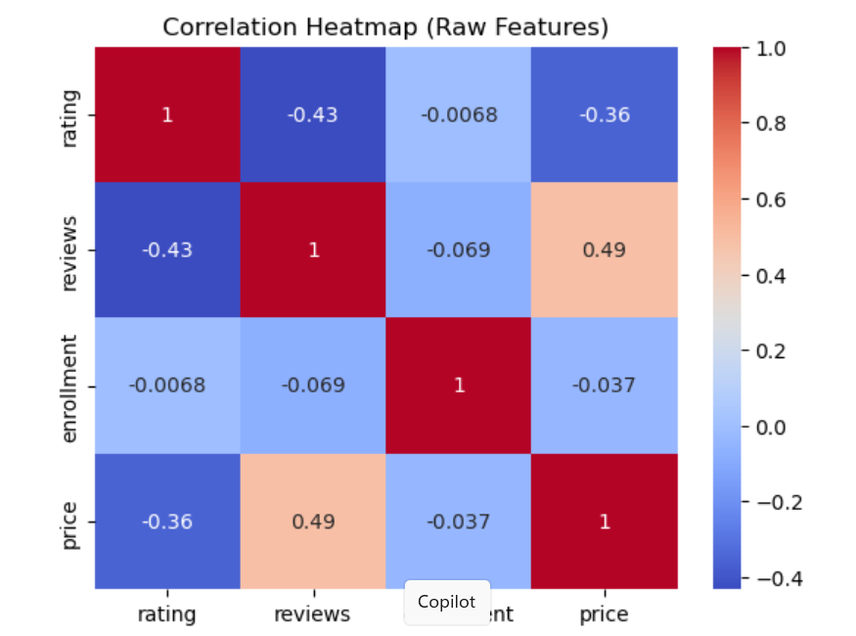
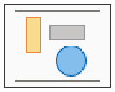

Slide 9
Additional EDA Visualizations
Distribution plots of success score
Box plots to detect outliers
Feature vs target scatter plots
📈 (EDA graphs included)

Slide 10
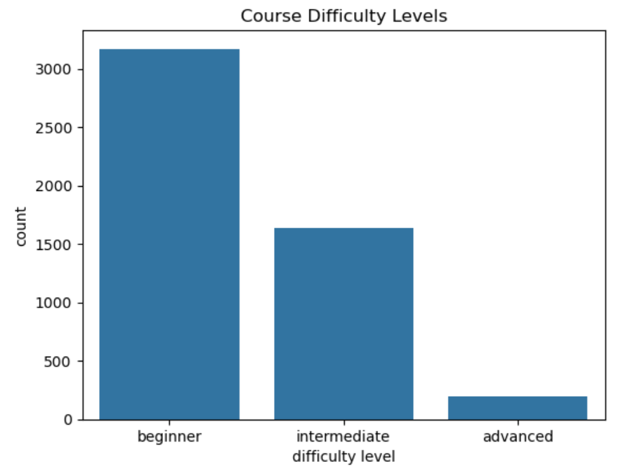

Slide 11
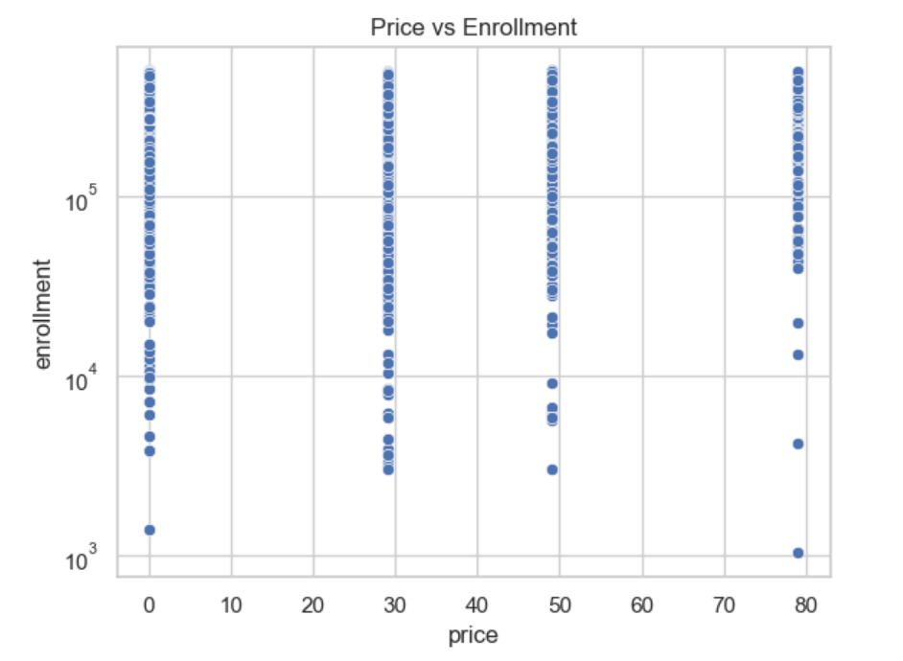

Slide 12
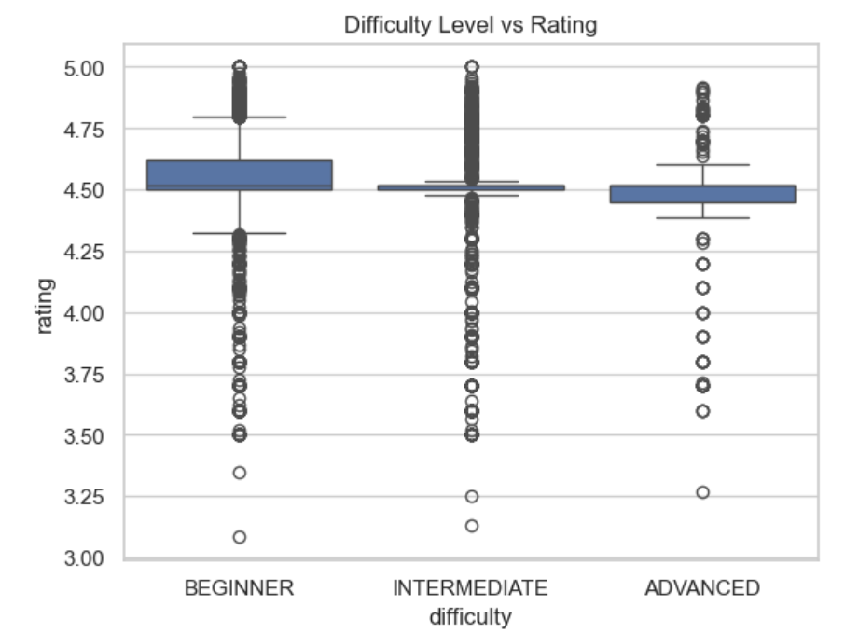

Slide 13
Model Selection
Regression-based problem formulation
Gradient Boosting Regression selected
Effective for non-linear and complex relationships

Slide 14
Gradient Boosting Regression – Overview
Models are built sequentially
Each model reduces the error of the previous one

Slide 15
Hyperparameter Tuning
Performed using GridSearchCV / RandomizedSearchCV
Optimized parameters like n_estimators, learning_rate, max_depth
Improved model accuracy and generalization

Slide 16
Cross Validation
Applied k-fold cross validation
Ensures model stability across different data splits
Reduces overfitting risk

Slide 17
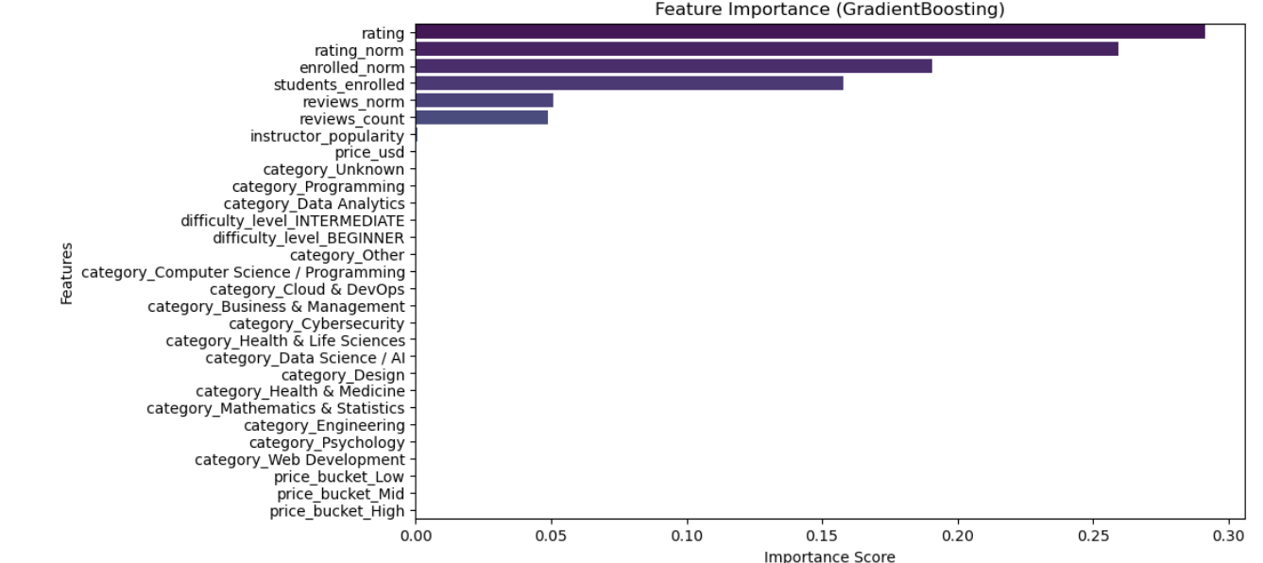
Feature importance (Gradient Boosting)

Slide 18
Model Training
Trained Gradient Boosting Regressor with tuned parameters
Used training dataset for learning patterns
Test dataset used for final evaluation

Slide 19
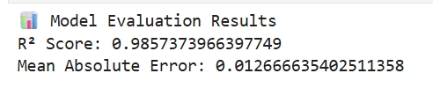
Model Evaluation
Metrics used: R² Score, MAE, MSE
Model achieved strong predictive performance
Consistent results across cross-validation folds

Slide 20
Model Saving
Final trained model saved using Pickle
Ensures reproducibility
Used directly in deployment stage

Slide 21
Web Application Development
Flask-based web application
User inputs learner and course features
Backend predicts success score

Slide 22
Prediction Workflow
User input → preprocessing
Model inference
Predicted success score displayed on UI

Slide 23
Generative AI–based Course Advisor
Integrated a Generative AI–based Course Advisor with the ML prediction system
GenAI generates context-aware recommendations based on:
Predicted success score
Course difficulty level
Learner engagement indicators
Enhances decision-making beyond numerical prediction

Slide 24
Results & Outcome
Accurate and reliable success score prediction
Complete ML pipeline implemented
Supports data-driven decision making

Slide 25
Future Enhancements
Real-time learner behavior tracking
Advanced ensemble models
Cloud deployment and monitoring

Slide 26
Conclusion
Successfully built an optimized ML regression system
Integrated EDA, tuning, validation, and deployment
Demonstrates strong applied data science skills

